Slide 1
SCHOOL MANAGEMENT SYSTEM

Slide 2
Introduction
IN School Management system there are ssc and cbse schools .in our website we can register and confirm our admission in top 10 ssc snd cbse schools in india.
Our website serves as a centralized platform where prospective students and parents can register and confirm admissions effortlessly.

Slide 3
Purpose and objective
Focusing on the top 10 SSC and CBSE schools, our user-friendly interface streamlines the enrollment process, providing a convenient and accessible way to secure placements in some of the most reputable educational institutions across the country.
Explore the possibilities and embark on your educational journey with confidence through our intuitive admission registration system.

Slide 4
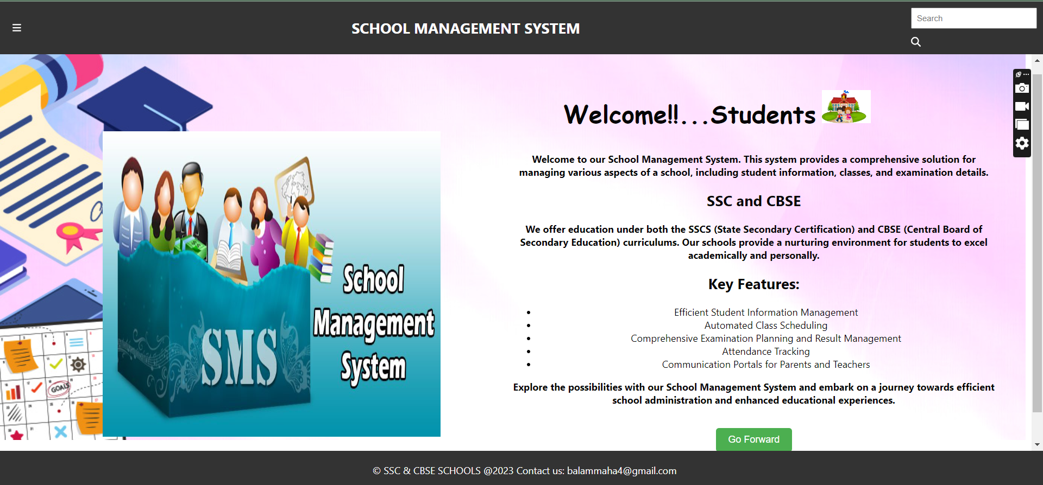
webpage

Slide 5
Benefits
Transparent School Selection
Easy Comparison of Top Schools
Simplified Admission Process
Data-Driven Decision-Making
Informed School Choice

Slide 6
conclusion
In conclusion, the envisioned enhancements to our school management system, including interactive features, predictive analytics, and streamlined processes, reflect our commitment to efficiency and user satisfactionThe project has designed the email system to be easy to use and helpful for people, which makes using it a good experience for users.

Slide 7
Future enhancement
In the future, we plan to upgrade our school management system by introducing interactive features like dynamic charts.Improvements include user-friendly dashboards, automated alerts, and enhanced reporting with graphical representations. Looking ahead in our email detection project, we want to make it even better.
We're also exploring mobile app integration for on-the-go access and a streamlined online admission process.

Slide 8


